Slide 1
The Program Manager’s Course PMT-401
Improving acquisition outcomes . . .
one graduate at a time

Slide 2
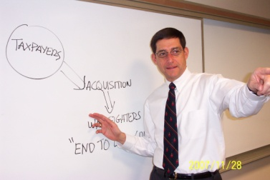
Program Manager’s Course PMT 401
The integration of four primary elements:
Students
Faculty
Construct
Facilities/IT
Content
GOAL: SENIOR ACQUISITION PROFESSIONALS
TO LEARN FROM EACH OTHER!

Slide 3
PMT-401 – What it is
PMT-401 is:
10-week intensive case study-based program modeled on the Harvard Case method
Designed to enhance analytical, critical thinking and decision making skills to better lead large complex programs
Blend of case studies (~70%) and non-case study learning events
Executive education-like approach
Student-centered learning
Rich learning experience unlike any other DAU course students have experienced previously

Slide 4
PMT-401 Purpose
An assignment specific course created to meet a specific gap for a specific audience:
Level III Program Management (PM) career field members who have demonstrated the potential to become major program or project managers and high potential Level III acquisition professionals in other career fields, such as Contracting, Logistics, and Financial Management.
Participants must be O-5/GS-14 or above with extensive experience in acquisition, including 4 years in or directly supporting a program organization.
Designed to improve acquisition outcomes by strengthening analytical, critical thinking and decision making skills to lead large, complex programs.
“Ten years of experience in ten weeks”
- former student

Slide 5
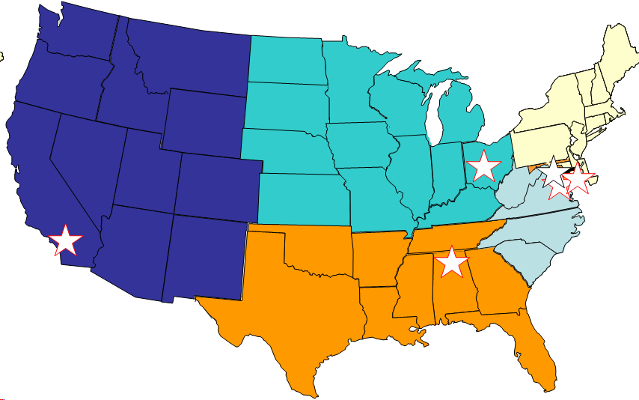
Locations of PMT-401 Course Offerings
Midwest Region
Kettering, OH
Defense Systems Management College
Ft. Belvoir, VA
West Region
San Diego, CA
South Region
Huntsville, AL

Slide 6
PMT-401 Today
Residence PMT-401 (10-week in-residence offering)
Three double offerings/year at Fort Belvoir, VA (56/offering)
Two offerings/year @ Kettering, OH (28/offering)
One offering @ Huntsville, AL (28/offering)
One offering @ San Diego, CA (28/offering)
Industrial College of the Armed Forces (ICAF)
Senior Acquisition Course elective (20/offering)
Army Senior Service College Fellowship (SSCF) Program
Three sites (Huntsville, AL; Warren, MI; Aberdeen, MD) – 24 Fellows

Slide 7
PMT-401 Students
Senior military and civilian acquisition leaders
O5/GS14 and above – Army, Navy, Air Force, DoD
Up to 8 equivalent industry managers per offering
Selected for or having potential to be ACAT I/II Program Managers
Over 85% Level III in Program Management
55 to 70% active duty military (mostly O5s)
Over 80% have one or more Masters Degree
7% have a Doctorate degree
Acquisition experience - 4 to >20 years
Average > 10.7 years

Slide 8
Typical Affiliation
IND, 5-8,10-12%
11-06
DoD, 3, 5%
USA, 13, 23%
USMC, 6, 11%
USA F, 20, 36%
USN, 9, 16%
Total Students = 56

Slide 9
Typical Demographics
11-06
Industry, 5-8, 10-12%
Government Civilian,
18, 32%
Military Officers, 33, 59%
Total Students = 56

Slide 10
What’s in PMT-401?
Almost 100 case studies in the course
Distinguished Guest Practitioners
Media Training
Capitol Hill Workshop
Leadership Simulation (Looking Glass)
Mentoring
Personal Growth Plan (360, MBTI, Headlines)
Networking with senior acquisition professionals
Electives & Seminars
Capstone Exercises (incl. Student Cases)

Slide 11
Themes Integrated in PMT-401
Broadened Perspectives
Industry Perspective
Stakeholders
Joint & International
Finance/POM/ Budget
Contracting/ Negotiating
Technology/ Systems Engineering
Manufacturing & Logistics
Information Technology
Test & Evaluation
Critical Thinking/Decision Making
Leading Through Change
Communications
Building Relationships/ Coalitions
Ethics
General Program Management
Personal Leadership
Acquisition Environment
Acquisition Domain Knowledge
Acquisition Management & Leadership

Slide 12
Functions Integrated in PMT-401
Better Buying Power initiatives
Industry Perspective
Engineering & Systems Theory
Financial Analysis
Logistics
Contracting/Control
Accounting & ROI
Lean Manufacturing
Public Relations
Systems Engineering
Program Management
Concept Formulation
Spiral Development
Testing
Technology Insertion
Critical, Creative, Strategic Thinking
Partnering
Industry Capture Process
Acquisition Initiatives
Information Technology
Negotiation
Dispute Resolution
Self Awareness
Acquisition Policy
Team Building
Transformation
Simulation
Research & Development
Product Development
Joint & International Management
Life Cycle Cost
Ethics
Cost Accounting
Leadership
Problem Solving
Integrated Product Teams

Slide 13
Course Construct
Case Studies – Skills Training
86 DAU developed cases (by title)
2 COTS cases (Harvard, Darden)
100 blocks; 150 hours large group discussion
50 hours small group discussion
100+ hours individual preparation (1 to 2 hours/case)
~70% of formal class time
Notes:
10 weeks x 5days/week = 150 theoretical teaching blocks
Minus: First and last days: -6 blocks
Federal holiday: -3 blocks
Study day: -3 blocks
Results in 138 available blocks
PMT 401 developed Acquisition Simulation – 3 blocks; 8 hours

Slide 14
PMT-401 Learning Process
Students typically spend 1 to 2 hours of preparation per case study – 3 to 6 hours/night in preparation for a 3 case day
Reflection
Learning
Individual Preparation
60+ minutes, depending
on the case
Small Group
30 minutes
Classroom Discussion
80 minutes
PMT-401 Four-stage Learning Process
Notes:
PMT-401 employs a four-stage learning process which requires one to two hours of individual preparation outside of class per case study. End of course feedback consistently verifies that students spend an hour or more analyzing each case study in preparation for class.
As part of encouraging students to develop “reflective practitioner” habits, we provide opportunities for students to reflect on how that case study situation applies to their program.

Slide 15
Course Construct
Case Studies – Skills Training
86 DAU developed cases (by title)
2 COTS cases (Harvard, Darden)
100 blocks; 150 hours large group discussion
50 hours small group discussion
100+ hours individual preparation (1 to 2 hours/case)
Exercises, Simulations and Seminars
Mount Everest Decision-making Exercise – 2 blocks; 3 hours
PPBE Seminar – 1.5 blocks; 2 hours
EVM, Contract Types, Risk Mgmt Seminars – 3 blocks; 4.5 hours
Media Training - 6 blocks; 16 hours
Looking Glass Leadership Simulation – 7 blocks; 18 hours
Negotiation Exercises – 5 blocks; 9 hours
Afternoon Seminars – 10+ optional seminars; 20+ hours
~70% of formal class time
Notes:
Plus the student developed case studies as a capstone exercise to apply their enhanced skills to an acquisition dilemma of their choosing
10 weeks x 5days/week = 150 theoretical teaching blocks
Minus: First and last days: -6 blocks
Federal holiday: -3 blocks
Study day: -3 blocks
Results in 138 available blocks

Slide 16
Course Construct (cont.)
Broadened Perspectives
12 (or more) Distinguished Guest Practitioners – 12+ hours
Capitol Hill Workshop – 6 blocks; 20 hours on Capitol Hill
PEO/SYSCOM (Fall offering only)
Personal Development
360 Feedback Instrument (Leadership Mirror) – 1 block; 2 hours
Advanced MBTI (Step II) instrument – 3 blocks; 4 hours
Faculty Assessment – 2 or 3 times
Electives – 3 blocks; 4.5 hours
Personal Growth Plans (Headline article)
International Acquisition Training
5 DAU International cases
Comparative Acquisition Systems seminar, Dr. Jerry Abbott, ICAF
Notes:
Plus
Team Critical Thinking and Action Learning
Developing cases on “real-time” student issues – 20 hours
Practice leading team critical thinking discussions – 10 hours

Slide 17
PMT-401 – more than “100 cases”; more than just defense acquisition
Develop critical thinking in their organizations
Manage the decision making process
Develop network of trusted advisors
Apply the power of good questions
Work on leadership and management skills in a safe environment
Listening
Open to ideas
Patience
Learn something about themselves to become more effective as a senior leader
Asking good questions
Question assumptions
Assess bias & perceptions
Notes:
The PMC experience is more than just case studies. Exercises, seminars and workshops broaden perspectives and provide opportunities to apply the course learning.

